Slide 1

5th Floor, Usnaz Tower, Church Landing Rd, near Medical Trust Hospital, Pallimukku, Kochi, Kerala 682016

Slide 2
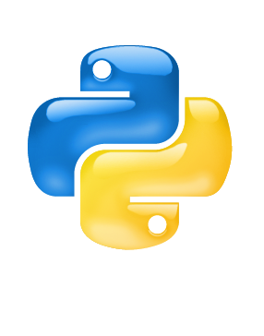
AGENDA
What is Python.
Uses of Python.
Python Features.
What can Python do?
Why Python?

Slide 3

What is Python?

Slide 4
Python is a popular programming language. It was created by Guido van Rossum, and released in 1991.
Python is a general-purpose, high-level, interpreted, object-oriented programming language used for a wide variety of applications.
Python is simple, easy to learn. Syntax emphasizes readability and therefore reduces the cost of program maintenance. In addition, it supports modules and packages, which encourages program modularity and code reuse.

Slide 5
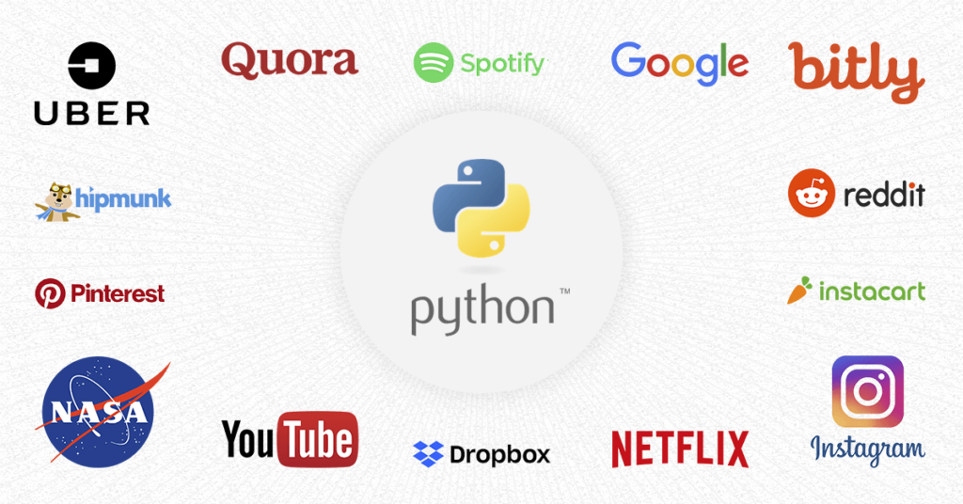

Slide 6
Uses of Python.

Slide 7
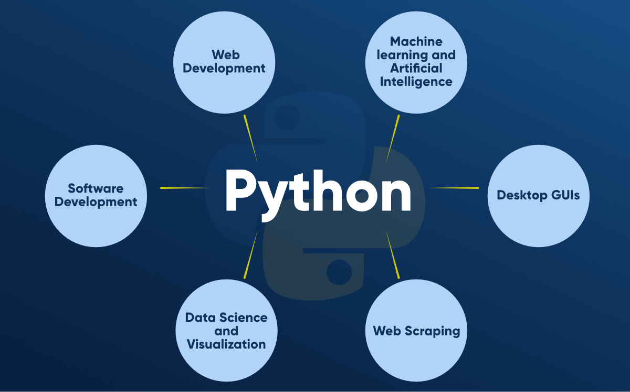

Slide 8
Python Features.

Slide 9
Free and Open Source
Python language is freely available at the official website. Download Python Since it is open-source, this means that source code is also available to the public. So you can download it, use it as well as share it.
Easy to code
Python is a high-level programming language. Python is very easy to learn the language as compared to other languages like C, C#, Javascript, Java, etc. It is very easy to code in the Python language and anybody can learn Python basics in a few hours or days. It is also a developer-friendly language.

Slide 10
Easy to Read
As you will see, learning Python is quite simple. As was already established, Python’s syntax is really straightforward. The code block is defined by the indentations rather than by semicolons or brackets.
Object-Oriented Language
One of the key features of Python is Object-Oriented programming. Python supports object-oriented language and concepts of classes, object encapsulation, etc.

Slide 11
Frontend and backend development
With a new project py script, you can run and write Python codes in HTML with the help of some simple tags <py-script>, <py-env>, etc. This will help you do frontend development work in Python like javascript. Backend is the strong forte of Python it’s extensively used for this work cause of its frameworks like Django and Flask.

Slide 12
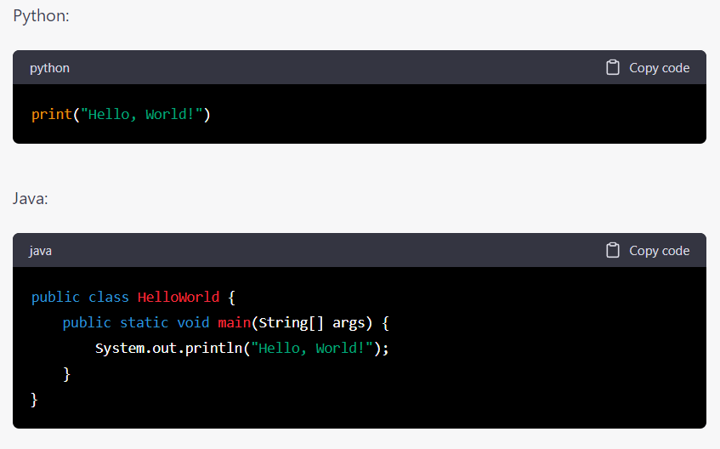

Slide 13
What can Python do?

Slide 14
Python can be used on a server to create web applications.
Python can be used alongside software to create workflows.
Python can connect to database systems. It can also read and modify files.
Python can be used to handle big data and perform complex mathematics.
Python can be used for rapid prototyping, or for production-ready software development.

Slide 15
Why Python?

Slide 16
Python works on different platforms (Windows, Mac, Linux, Raspberry Pi, etc).
Python has a simple syntax similar to the English language.
Python has syntax that allows developers to write programs with fewer lines than some other programming languages.
Python runs on an interpreter system, meaning that code can be executed as soon as it is written. This means that prototyping can be very quick.
Python can be treated in a procedural way, an object-oriented way or a functional way.

